Slide 1
Lecture 14 OpenMP
Prof. Brendan Kochunas
10/23/2019
NERS 590-004

Slide 2
Outline
Introduction to OpenMP
Execution model and creating threads
Loop Parallelism
Synchronization
Data Environment
Beyond the Common Core

Slide 3
Today’s Learning Objectives
What you should take away from today’s lecture
Understand the execution model of OpenMP
Know the “core” constructs of OpenMP
Understand the details of the OpenMP data environment
Know how to modify code to make use of OpenMP and run this code
Be aware of what else OpenMP has to offer

Slide 4
What is OpenMP
OpenMP started in 1997 as a simple interface for scientists.
Complexity has grown substantially over the years!
OpenMP is an Application Programming Interface (API) for writing multithreaded applications
A set of compiler directives and library routines
Greatly simplifies writing multi-threaded applications in C/C++ and Fortran
Standardizes established symmetric multi-processing with vectorization and heterogeneous device programming
The full spec is overwhelming, so we’re going to focus on the essential constructs used by nearly all OpenMP programmers.

Slide 5
OpenMP Software Stack
Only showing most common usage.
NUMA and GPU support were added later.

Slide 6
Flux node
Architecture
(Extent of hardware to
consider with OpenMP)

Slide 7
Basic models of Programming in OpenMP
Fork/Join
Pool of Tasks
Simple loop parallelization
Tasks are independent units of work composed of
Code to execute
Data to compute with
Thread
Thread
Thread
Fork
Join
Thread
Scheduler
Tasks
Nested Parallelism
Thread
Thread

Slide 8
Basic Syntax
Most of the constructs in OpenMP are compiler directives.
C/C++ #pragma omp <construct> [<clause> [<clause>] ...]
Fortran !$OMP <construct> [<clause> [<clause>] ...]
Examples
#pragma omp parallel private(x)
!$OMP parallel private(x)
Function interface declarations and compile time constants and types in either:
#include <omp.h>
USE OMP_LIB
Most OpenMP constructions apply to a “structured block”.
Structured block: a block of one or more statements with one point of entry at the top and one point of exit at the bottom
Examples: in C/C++ anything inside “{}”; in Fortran its loops, subroutines, functions, etc.

Slide 9
Enabling OpenMP
Switches for compiling and linking
Compiler | Flag
GNU gcc/g++/gfortran | -fopenmp
PGI pgcc/pgf90 | -mp
Intel (Windows) icl/ifort | /Qopenmp
Intel (Linux/OSX) icc/icpc/ifort | -fopenmp
IBM xlc/xlcxx/xlf77/xlf90/xlf95/xlf2003 | -qsmp
NAG nagfor | -openmp
Cray | -h omp

Slide 10
Execution Model

Slide 11
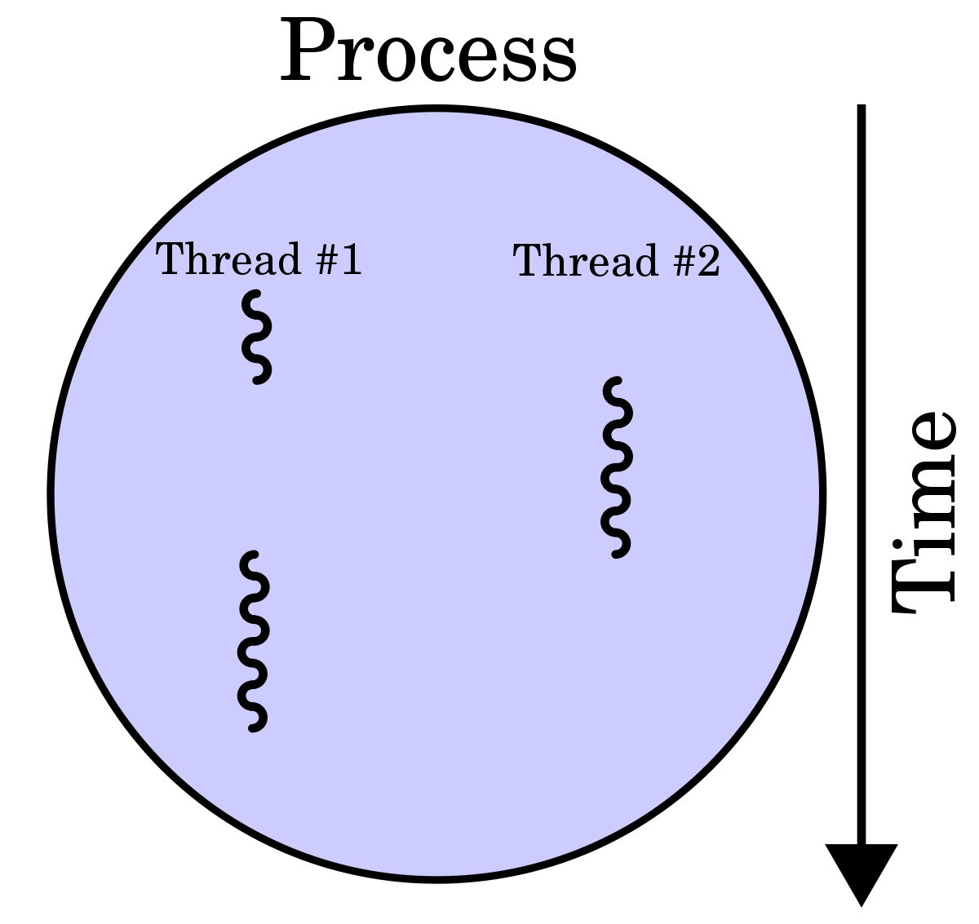
Concept of a Thread
Ability for the hardware/operating system to execute multiple processes concurrently
Typically process = thread
In multi-threading a process can have multiple threads
Usage of “process” and “thread” is confusing
In Linux the top command (short for table of processes) lists all processes
These are basically threads
Bottom line is that a thread is a software entity, not a hardware entity

Slide 12
Thread Affinity
Affinity - association of thread (software) with core (hardware)
This is not guaranteed.
By default OS and OpenMP runtime library control this.
Threads can “drift” from core to core during execution
Fortunately, thread affinity can be controlled
OMP_PROC_BIND – false|true|master|close|spread
OMP_PLACES – specify exactly which threads go where e.g. cores, sockets, threads or location list {location:number:stride}[,{location:number:stride}]
Notes:
False – no binding
True – bind them, location is determined by OS/OpenMP runtime
Master – collocate threads with master thread
Close – place threads close to master thread
Spread – spread out threads as much as possible

Slide 13
Affinity Example (1 socket)
12 threads, every other core
OMP_PROC_BIND=close
OMP_PLACES=cores

Slide 14
Affinity Example (No shared L3)
2 threads, one on each socket
OMP_PROC_BIND=true
OMP_PLACES=sockets

Slide 15
Affinity Example (alternating)
12 threads, every other core
OMP_PROC_BIND=spread
OMP_PLACES=cores

Slide 16
Thread Creation & Destruction
C/C++
Fortran
double A[1000];
omp_set_num_threads(4);
#pragma omp parallel
{
int ID = omp_get_thread_num();
int nthrds = omp_get_num_threads();
pooh(ID,A);
}
REAL(8) :: A(1000)
INTEGER :: id,nthrds
omp_set_num_threads(4)
!$OMP PARALLEL
id=omp_get_thread_num();
nthrds=omp_get_num_threads();
CALL pooh(id,A)
!$OMP END PARALLEL

Slide 17
Controlling the Number of Threads
There are a few ways to do this...
Use the omp_set_num_threads()
This changes an “internal control variable” the system queries to select the default number of threads in subsequent parallel constructs
To change without re-compilation one can INSTEAD use environment variables associated with OpenMP
When an OpenMP program starts up, it queries an environment variable OMP_NUM_THREADS and sets the appropriate internal control variable to the value of OMP_NUM_THREADS
e.g. $ export OMP_NUM_THREADS=12

Slide 18
Hello World Example

Slide 19
C/C++
Serial
Threaded
#include <stdio.h>
int main ()
{
printf("Hello World \n");
}
#include <stdio.h>
#include <omp.h>
int main ()
{
omp_set_num_threads(4);
#pragma omp parallel
{
int id = omp_get_thread_num();
printf("Hello World from thread = %d", id);
printf(" with %d threads\n",omp_get_num_threads());
}
}

Slide 20
Data Environment

Slide 21
Consider the following scenario
1: int a;
2: a=10
3: omp_set_thread_num(4);
4: #pragma omp parallel
5: {
6: int id = omp_get_thread_num();
7: printf(“On thread = %d, a=%d", id, a);
8: }
T0 – New Stack, a=??
a=10
T1
New
Stack
T2
New
Stack
T3
New
Stack
a = ???

Slide 22
Data Environment Default Behavior
Most variables are shared
Actual behavior depends on how/where variable is defined
Global variables default to SHARED
In Fortran: COMMON blocks, variables with SAVE attribute, and module variables, dynamically allocated arrays
In C/C++: file scope variables, static variables, and dynamically allocated memory
Default private variables include
Stack variables and automatic variables
Default behavior can be declared explicitly with default clause
default(none|shared|private)

Slide 23
Controlling Data Environment
When declaring new parallel sections, OpenMP provides clauses for defining the data environment.
shared – variable retains one copy in memory, threads do not duplicate anything
private – specify which variables are private amongst threads
Creates local copies of variables. Variables have typical automatic definitions of serial code (e.g. declared but not defined). Note fixed sized arrays are duplicated!
Special cases
firstprivate – create local copies and initialize all of them to their state just before the parallel construct. Note this duplicates all arrays!
lastprivate – variable is set equal to the private version of whichever thread executes the final iteration of for-loop or last section of sections construct.

Slide 24
Parallel Loops

Slide 25
Parallel For - C
int main() { ... serial code ... #pragma omp parallel for
for (i=0; i<n; i++) a[i] = b[i] + c[i] ... more serial code ... }
int main() { ... serial code ... #pragma omp parallel
#pragma omp for for (i=0; i<n; i++) a[i] = b[i] + c[i] ... more serial code ... }

Slide 26
Parallel For- Fortran
program ... serial code ... !$omp parallel do do i = 1,n a(i) = b(i) + c(i) enddo !$omp end parallel do
... more serial code ... end program
program ... serial code ... !$omp parallel
!$omp do do i = 1,n a(i) = b(i) + c(i) enddo
!$omp end do !$omp end parallel
... more serial code ... end program

Slide 27
Loop scheduling
OpenMP lets you control how a threads are assigned iterations of a parallel loop:
static – equal-sized chunks of iterations are assigned to each thread. When a thread finishes, it waits for the others.
dynamic – threads obtain a new chunk when their current chunk is finished.
guided – chunk size starts off large and decreases, for better load balancing.
auto – let the compiler choose.
runtime –the OMP_SCHEDULE environment variable determines the scheduling strategy

Slide 28
How to schedule?
Chunk Size
When to use what?
A chunk is a block of iterates
e.g. do i=1,1000 can have chunk size of 1 or 10 or 100, etc.
Chunk size can often be utilized to “tune” certain loops.
Chunk size can be specified as a variable
e.g. chunk=niters/(10*nthreads) each thread would receive about 10 chunks
Schedule | When to use
STATIC | Any loop iteration takes about as long as any other loop iteration
DYNAMIC | Large variability in time of each loop iteration
GUIDED | Some variability in time of each loop iteration

Slide 29
Illustration of Different Schedules
Static
Static (chunk=2)
Dynamic
Guided

Slide 30
Parallel Loop Example

Slide 31
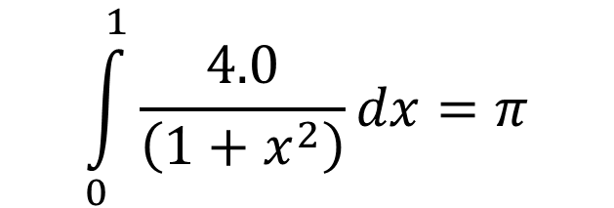
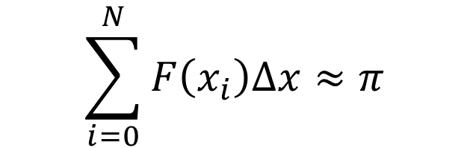
Numerical Integration of pi
$$\int_{0}^{1}{\frac{4.0}{\left(1+x^{2}\right)}dx}=π$$
Approximate as a summation of rectangles (midpoint rule)
$$\sum_{i=0}^{N}{F\left(x_{i}\right)Δx}≈π$$
Each rectangle has width $Δx$ and height $F\left(x_{i}\right)$ at the middle of the interval i.

Slide 32
Serial Code
static long num_steps = 100000000;
double step;
int main()
{
int i;
double x, pi, sum = 0.0;
double start_time, run_time;
step = 1.0/(double) num_steps;
start_time = omp_get_wtime();
for (i=1;i<= num_steps; i++){
x = (i-0.5)*step;
sum = sum + 4.0/(1.0+x*x);
}
pi = step * sum;
run_time = omp_get_wtime() – start_time;
printf(“\n pi with %ld steps is %lf in
%lf seconds\n ",num_steps,pi,run_time);
}

Slide 33
Parallel Solution 1
#pragma omp parallel num_threads(MAX_THREADS)
{
id = omp_get_thread_num();
sum[id] = 0.0;
#pragma omp for
for (i=1;i<= num_steps; i++){
x = (i-0.5)*step;
sum[id] = sum[id] + 4.0/(1.0+x*x);
}
}
for(i=0; i < MAX_THREADS; i++)
fsum += sum[i];
pi = step * fsum;
}
#define MAX_THREADS 4
static long num_steps = 100000000;
double step;
int main()
{
int i;
double x, pi, fsum = 0.0;
double sum[MAX_THREADS];
double start_time, run_time;
step = 1.0/(double) num_steps;

Slide 34
Analysis
Issue is with computing sum across threads.
Threads should compute partial sums and then we sum across threads.
Recall from Lecture 12 this is a reduction operation
Alternatively, we can enforce each thread to access sum one at a time.
This involves synchronization
for (i=1;i<= num_steps; i++){
x = (i-0.5)*step;
sum = sum + 4.0/(1.0+x*x);
}

Slide 35
False Sharing
If you promote scalars to arrays to avoid race conditions and compute a partial sum, the cache may “slosh” back and forth between threads.
The reason for this is the array elements are contiguous in memory and hence share a cache lines. This sharing of elements causes cache misses due to conflicts (also sometimes called collisions or interference) which is due to organization.
The result is the observation of poor scalability.
One solution is to pad the array so elements that need to be accessed by each thread appear on different cache lines.

Slide 36
OpenMP clauses for reduction
#pragma omp for reduction(op:var[,var2,…])
Added for convenience since reductions are very common (e.g. any integral)
#pragma omp for reduce(+:sum)
for (i=1;i<= num_steps; i++){
x = (i-0.5)*step;
sum = sum + 4.0/(1.0+x*x);
}
Operator | Initial Value
+ | 0
* | 1
- | 0
min | Largest pos. number
max | Most neg. number
And | true
Or | false
And there are many others…

Slide 37
Synchronization

Slide 38
Synchronization Constructs
Critical
Atomic
One thread executes structured block of code at a time
for (i=1;i<= num_steps; i++){
x = (i-0.5)*step;
sum[id] = sum[id] + 4.0/(1.0+x*x);
}
#pragma omp critical
{
for(i=0; i < MAX_THREADS; i++)
fsum += sum[i];
pi = step * fsum;
}
One thread executes statement one at a time
for (i=1;i<= num_steps; i++){
x = (i-0.5)*step;
#pragma atomic
sum = sum + 4.0/(1.0+x*x);
}

Slide 39
Fundamental synchronization
Barrier
Example
Threads are held at barrier until all threads all threads are at barrier.
Primarily should be used to enforce concurrency
Meaning you as programmer know that all threads have completed statements prior to barrier
This is sometimes a necessary condition for correctness of statements following barrier
Also useful for debugging
Practically, you should not ever need to use these.
#pragma omp parallel
{
//threaded operations on big matrix
#pragma omp barrier
//write matrix to file
}

Slide 40
Implied Barriers
#pragma omp parallel
{
id = omp_get_thread_num();
sum[id] = 0.0;
#pragma omp for
for (i=1;i<= num_steps; i++){
x = (i-0.5)*step;
sum[id] = sum[id] + 4.0/(1.0+x*x);
}
}
for(i=0; i < MAX_THREADS; i++)
fsum += sum[i];
pi = step * fsum;
}
Several contstructs in OpenMP have implied barriers
Implied barriers can be overridden with a NOWAIT clause.
Constructs with implied barriers
omp parallel (at the end, cannot override)
omp for (end of loop)
omp single (end of construct)
omp section (end of construct)
Implicit barriers

Slide 41
Summary of Common Core

Slide 42
Most OpenMP programs use just these functions, constructs and clauses

Slide 43
Beyond the Common Core

Slide 44
Newer, Gee-wiz-wow OpenMP Features
Fine grained task control
Task dependencies, tied vs. untied tasks, task groups, and task loops
Vectorization constructs
Simd, simdlen, uniform, inbranch vs. nobranch
Heterogeneous computing
Target, copyin, declare target, map, teams distribute parallel for
Other synchronizations
Locks, flush, other atomics: read, write, capture, update

Slide 45
This material is based on material developed by Tim Mattson for the ATPESC workshop.
See: https://extremecomputingtraining.anl.gov/sessions/presentation-the-openmp-common-core-a-hands-on-exploration/

